Slide 1
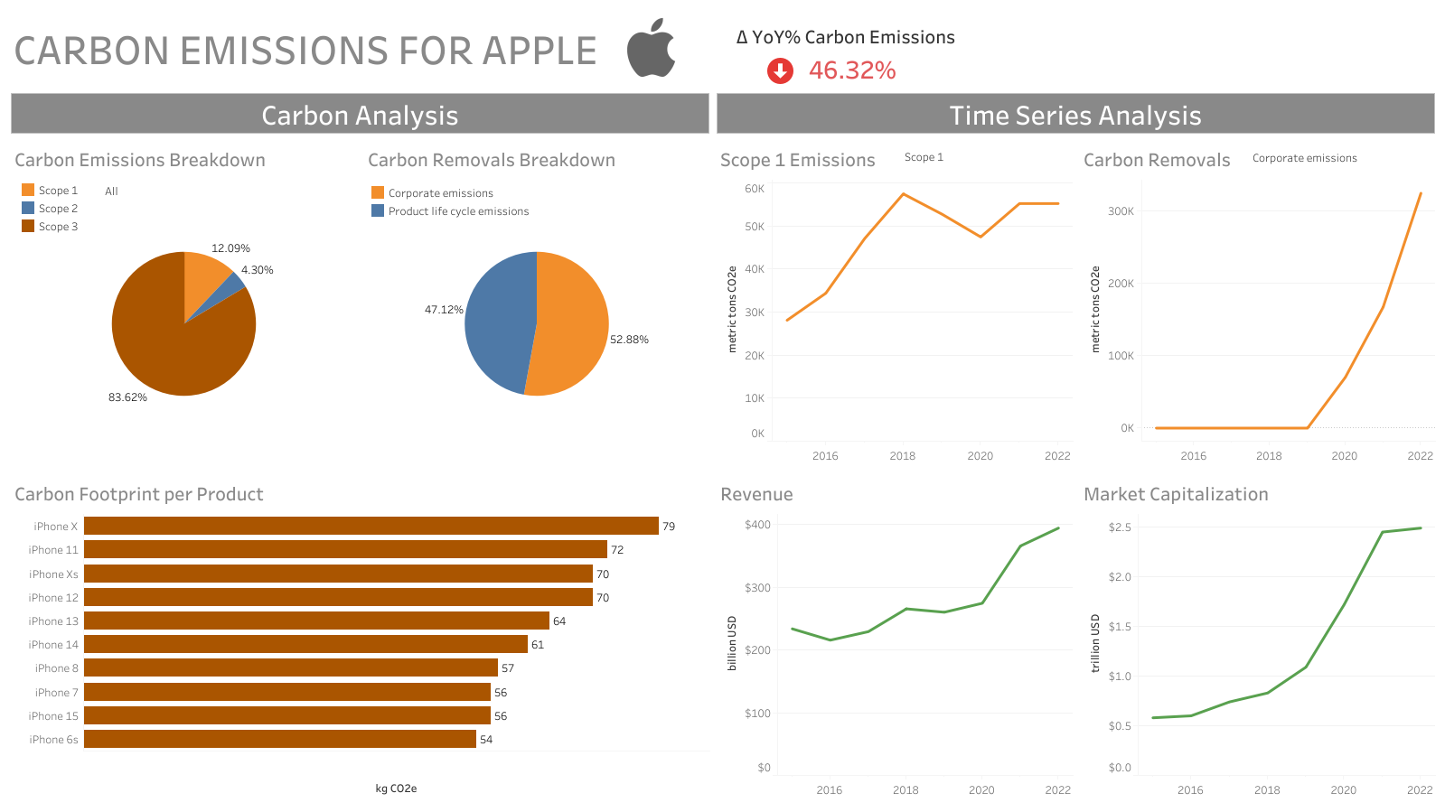

Slide 2
Abstract
I created a dashboard that evaluates the progress of Apple in becoming carbon neutral.
I performed an exploratory analysis of Apple’s Carbon Emissions dataset.
Apple aims to reduce carbon emissions by 75% and become carbon neutral by 2030.

Slide 3
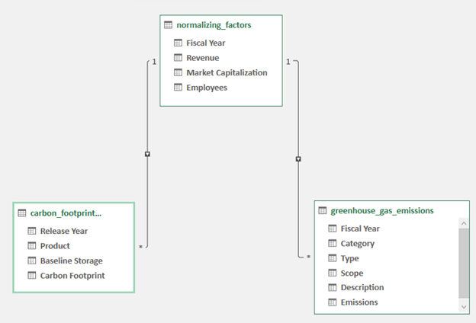
Data Model

Slide 4
Insights
Carbon Emissions
Total carbon emissions have been reduced by 46.32% from 2015-2022.
Scope 3 Emissions have been the dominant contributor to carbon emissions from 2015-2022.
Scope 1 Emissions have increased while Scope 2 and Scope 3 Emissions have decreased from 2015-2022.
Corporate Emissions removals increased from 2015-2022.
Carbon Removals
Product Life Cycle emission removals peaked in 2021.
Company Insights
iPhone X produced the most carbon footprints at 79 kg CO2e.
Revenue and market capitalization have been increasing from 2015-2022.

Slide 5
Recommendations
Apple should continue its current pace for reducing carbon emissions.
Apple should make more efforts to reduce its Scope 3 emissions.
Apple should make more efforts to reduce its carbon footprint on iPhone X products.
Apple should maintain its strong revenue and market capitalization business model.

